Slide 1


WELCOME
RESTAURANT ANALYSIS

Slide 2

Group - 05
Sachin Kakde
Bhagyashree B.
Nived Puttewar
Prabhu Patil
Priyanshu Nankal
Shrikant Warang
Kavali Bhanu Prakash

Slide 3

Zomato is an Indian multinational restaurant aggregator and food delivery company that started in 2008.
It serves as a platform for discovering restaurants, providing menus, user reviews, online food ordering, and table reservations.
Zomato's growth has been characterized by its diverse services, including seamless integration for online ordering, table reservations, and in-app cashless payments.
Its success story stems from providing comprehensive restaurant information, menus, and user reviews, contributing to its status as a leading food delivery startup and restaurant aggregator in India.
Zomato's fiscal year ending March 2023 recorded significant growth, with revenues surging to Rs 7,079 crore, up by 68.9% from Rs 4,192 crore in the previous fiscal year

Slide 4
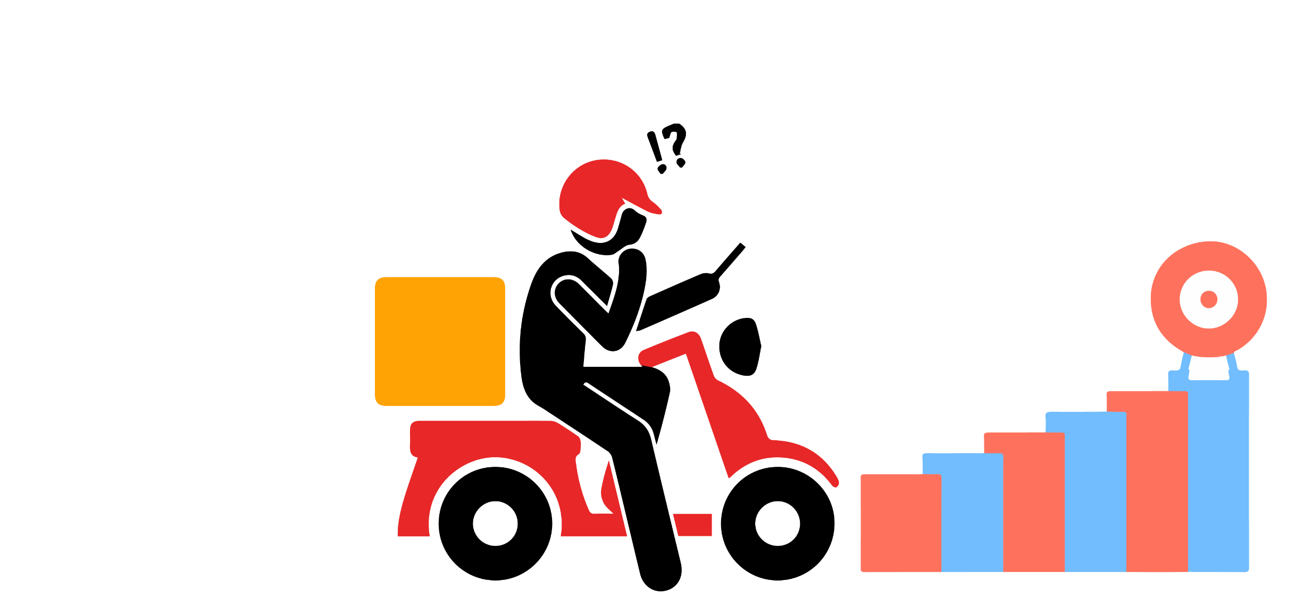
CHALLENGES OF ZOMATO
Competitive Market
Rapidly Evolving food Industry
Managing Logistics and Delivery for timely delivery.
Maintaining consistent quality across various restaurants
Balancing and moderating user reviews and ratings to maintain a fair and trustworthy platform
Balancing Growth and Cost and managing financial growth
Adapting to rapidly changing consumer preferences, dietary trends, and technological advancements requires continuous innovation and flexibility.

Slide 5

DATA MODELING
Data modeling is the process of creating a visual representation of either a whole information system or parts of it to communicate connections between data points and structures.
Challenges
Lack of data quality and consistency
Large data set may reduce data quality
Inadequate understanding of business needs
choosing of right data model

Slide 6

OBJECTIVES
Uncover and analyze user preferences for cuisines, price ranges, and service offerings.
Analyze popular cuisines, average cost for two, and user interaction with services like table booking and online delivery.
Understand trends in user ratings and reviews to gauge customer satisfaction and preferences.
Gain insights into Zomato's market presence and regional preferences.
Explore the distribution of restaurants across different regions, countries, and cities.
Analyze the number of restaurant openings over time (yearly, quarterly, monthly) to identify growth patterns.
Determine the percentage of restaurants offering table booking and online delivery.

Slide 7
ANALYSIS
- India has highest numbers of restaurants among 15 Countries.
- North Indian cuisines is most famous cuisines in all over Zomato restaurants.

Slide 8
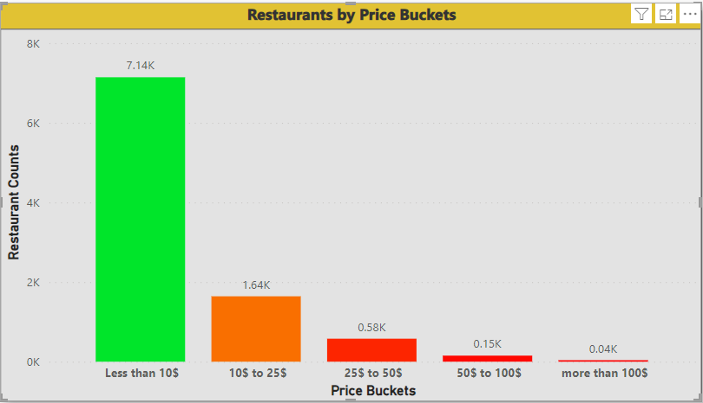
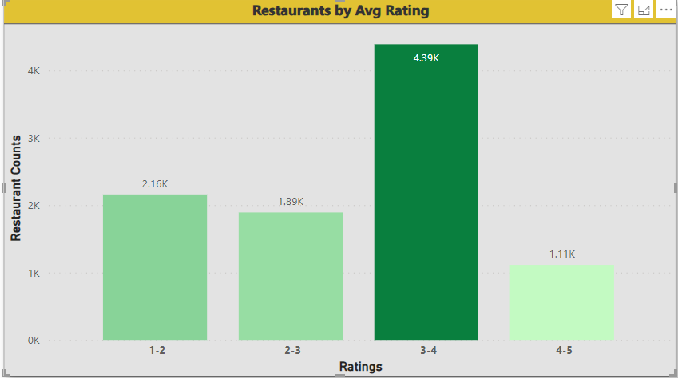
ANALYSIS
- 7.14k Restaurants comes has less than 10$ average price for two peoples.
Only 4.39 k Restaurants has average rating of 3 to 4.
As compared to 4 to 5 rating buckets, there are maximum number of restaurants has 1 to 2 ratings

Slide 9
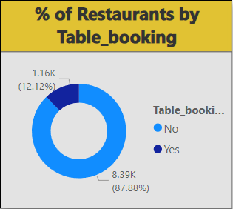
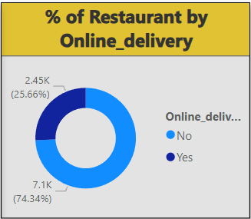
ANALYSIS
87.88% Restaurants doesn’t
Accept table booking
- Averagely 1k Restaurants were opened per year.
74.34% Restaurants doesn’t
Provide delivery

Slide 10

FINDINGS
Popular Cuisines: North Indian, Mughlai, fast foods emerged as the most favored among users, indicating strong preferences in taste.
Service Offerings: only 25% of restaurants provide online delivery.
Geographical Insights: Concentration of restaurants is highest in India, indicating strategic market dominance.
Ratings and Satisfaction: Majority of restaurants maintain an average rating of 3-4, highlighting overall satisfaction.

Slide 11
CONCLUSIONS AND SUGGESTIONS
Global Expansion Strategy: Leveraging the dominant presence in India, Zomato should focus on global expansion strategies to diversify its market reach and user base.
Enhancing User Ratings: Implementing measures to improve user ratings across restaurants, emphasizing quality and customer service, will enhance the platform's credibility.
Online Delivery Expansion: Converting a significant portion of restaurants currently not offering online delivery could significantly benefit the platform by meeting users' preferences for convenience.
Strategic Partnerships: Collaborating with local restaurants and forming strategic partnerships can aid in expanding service offerings and geographical presence.
User Engagement Initiatives: Implementing user engagement campaigns, incentivizing reviews, and introducing loyalty programs could improve user interactions and overall satisfaction.

Slide 12
THANK YOU!

